Slide 1
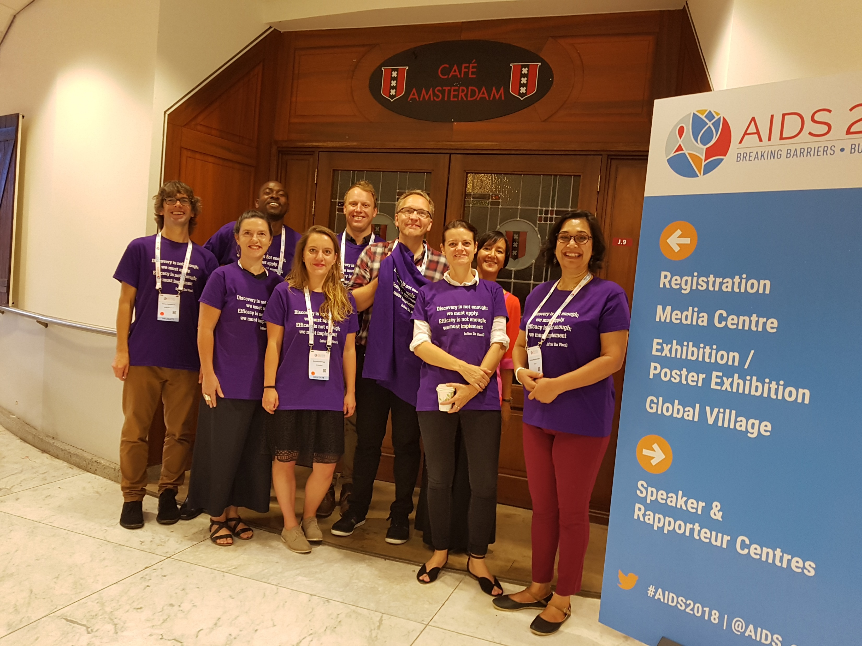
Track E: Implementation research, economics, systems and synergies with other health and development sectors
The Implementers
Nina Anderegg
Parinita Bhattacharjee
Shona Dalal
Mitzy Gafos
James Hargreaves
Bernadette Hensen
Collin Mangenah
Nancy Padian
Matthew Quaife
Brian Rice

Slide 2
Track E: The Context
The world is changing
Building bridges in the SDG era: Time for health system integration and an intersectoral response
Breaking barriers: Recognise and correct a prevention crisis
Universal Health Care and a focus on “key” populations
The toolbox continues to strengthen: (TLD, PrEP, U=U …)
Cascades, cascades everywhere: big news on the horizon
Implementation science: the time has come

Slide 3
What did we look for in Track E?
ART
Condoms
PrEP
VMMC
Safe sexual behaviour
…
Efficacious tools
Coverage among popns in need
Impact
Existing implementation strategies
Improved implementation strategies
Implementation Science Studies
Implementation strategies are complex interventions
Targeting and differentiation
Programme components
Platforms for delivery
Vertical / horizontal
Intersectoral synergy
Cost / financing
Data systems
Rigorous, pragmatic impact evaluations
Process evaluation of programme implementation
Costing / cost effectiveness studies
Robust service delivery data to track the epidemic and drive the response
Systematic Reviews of implementation studies
Policy research and new relevant to implementation and financing
And … what’s missing?

Slide 4
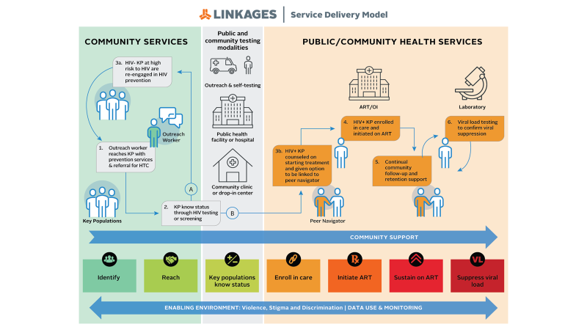
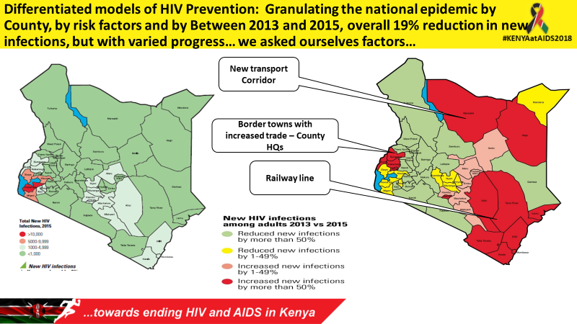
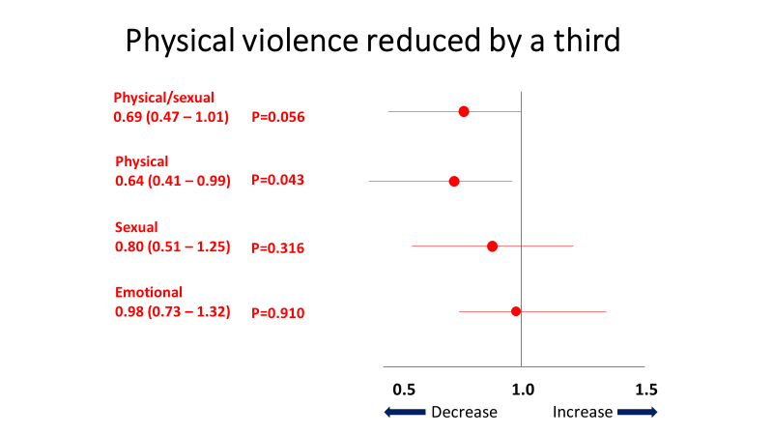
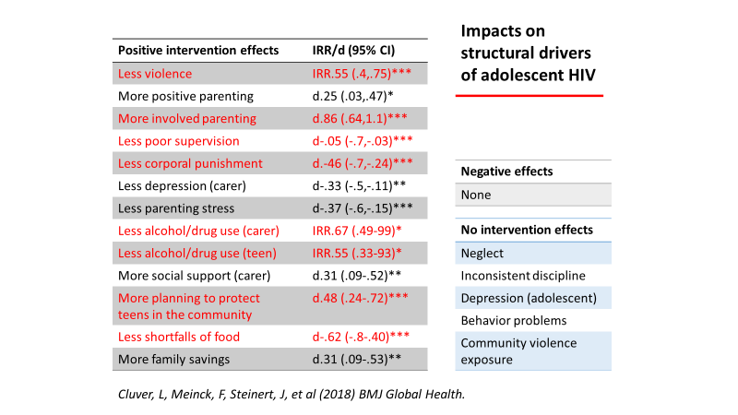
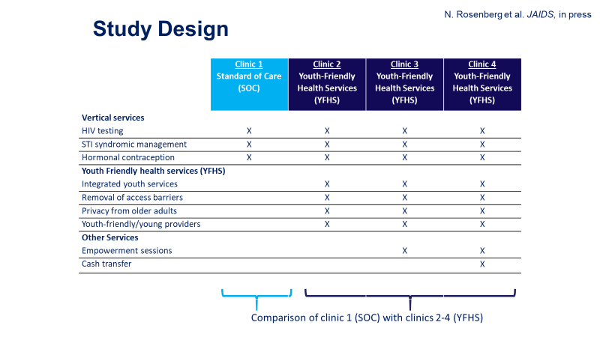
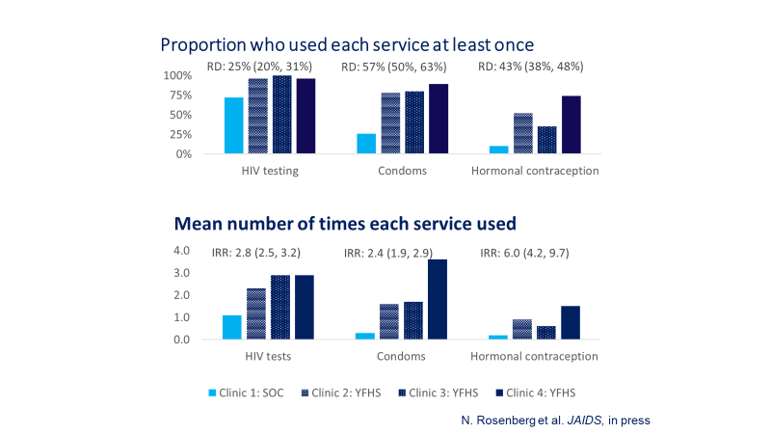
Combination and differentiated prevention programming
Data-guided prevention in Kenya: geography (Kilonzo)
Data driven prevention LINKAGES (Akolo) and in Kenya (Bhattacharjee)
DREAMS - ? Promising signs (Birx)
Youth friendly clinics led to more HIV tests and more condoms picked up (Rosenberg)
Microfinance reduced physical violence (Harvey)
“Cash and care” improved parenting skills (Cluver)

Slide 5
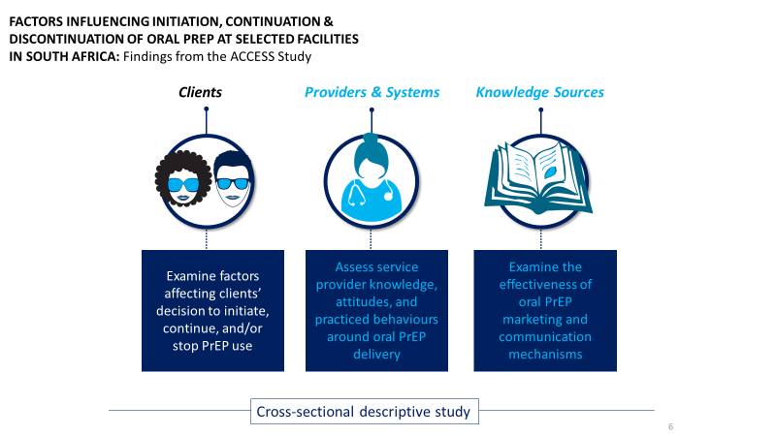
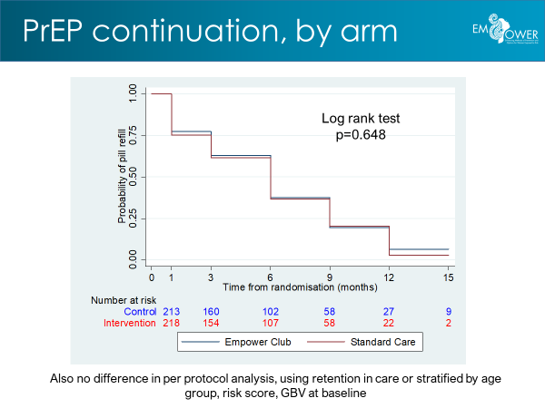
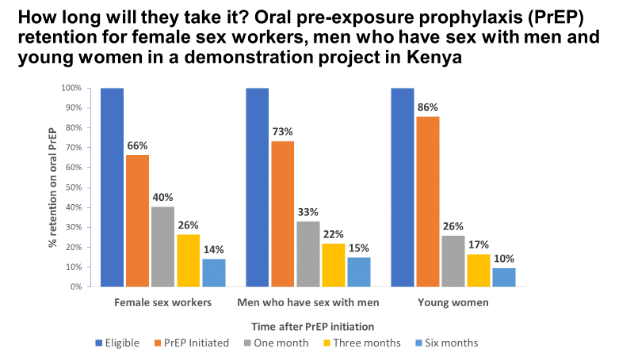
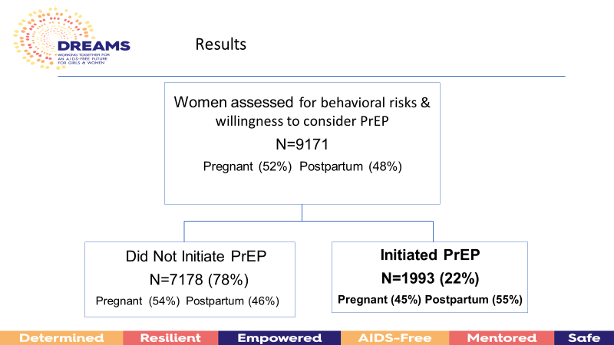
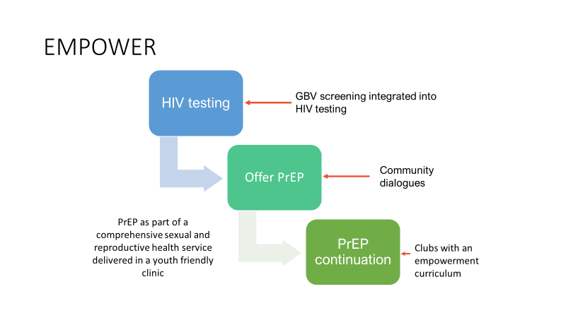
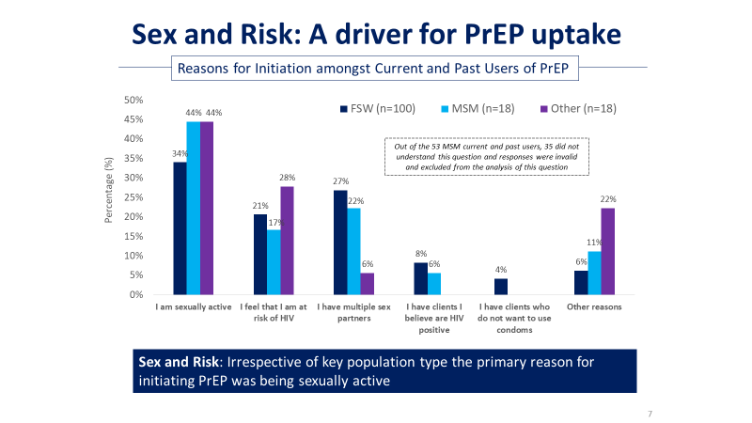
PrEP implementation …. P=P!
Prevenir study shows no new infections in daily or on demand PrEP
Demand and uptake variable, and optimal strategies not yet implemented
“Normalisation through better messaging” (Baeten), address risk perception, stigma
ACCESS South Africa
PriYa
Continuation variable, multiple factors optimal strategies not yet implemented
EMPOWER (Delaney-Moretlwe)
Kenya Demonstration (Kyongo)

Slide 6
Universal Test and Treat: what now?
… TasP
MaxART
SEARCH (Halvir)
“Ya Tsie” (Makhema)
HPTN (071) PopART ….

Slide 7
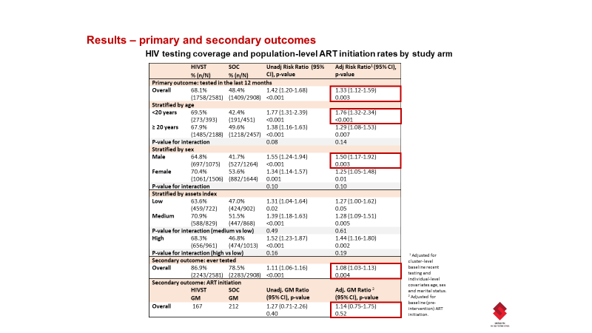
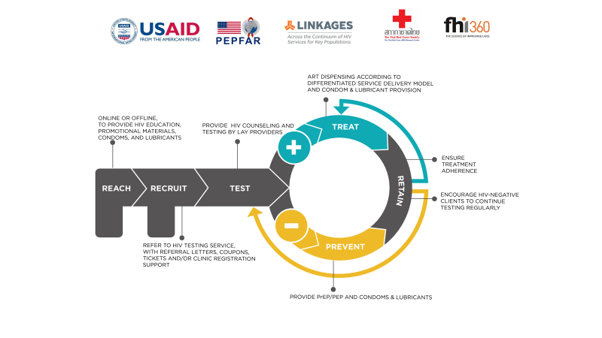
Testing: toward the first 90
Outreach to men
Weekend Testing (Geoffroy)
Secondary distribution of self-tests to young women (Agot)
Self-testing
Increases testing rates and ART initiation (STAR, Malawi)
Does not undermine linkage (Floyd)
Index and network-based testing
Optimised case finding increases yield (Ukraine)
Testing to prevention
Thai Red Cross

Slide 8
Linkage and Retention: the second and 3rd 90s
Clinic level barriers (Malebranche)
Engagement in methadone maintenance therapy improves treatment success among people who use drugs in Vancouver, Canada (Barker)
Urban adherence clubs reduce late drug pickups in Zambia (Roy)
ART community delivery non inferior in Tanzania (Francis)
Appointment spacing feasible in Ethiopia; High retention with community ART groups (Mozambique) and peer mentoring (UK)

Slide 9
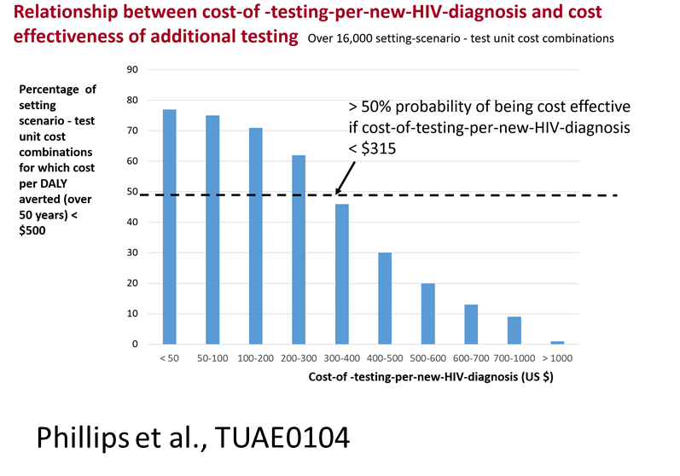
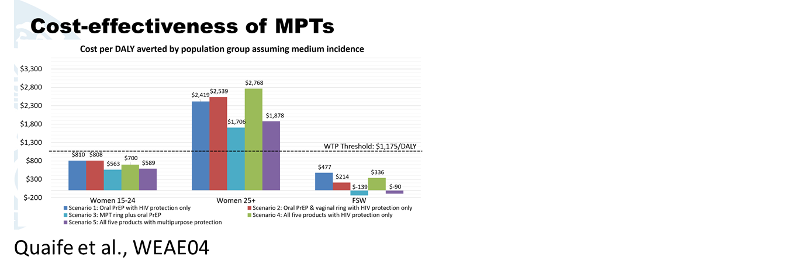
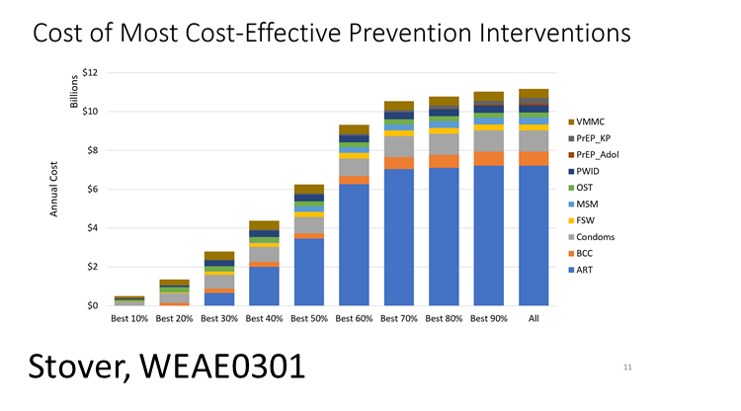
Cost effectiveness and priority setting
Additional testing in men likely to be cost effective if <500USD per case found (Phillips)
Future multi purpose prevention technologies likely to be cost effective in young women and female sex workers in South Africa while incidence remains high (Quaife)
Most cost-effective interventions (condoms, VMMC, outreach to sex workers) require only 15% of direct intervention resources. They are currently implemented/funded at only 70% of need (Stover)

Slide 10
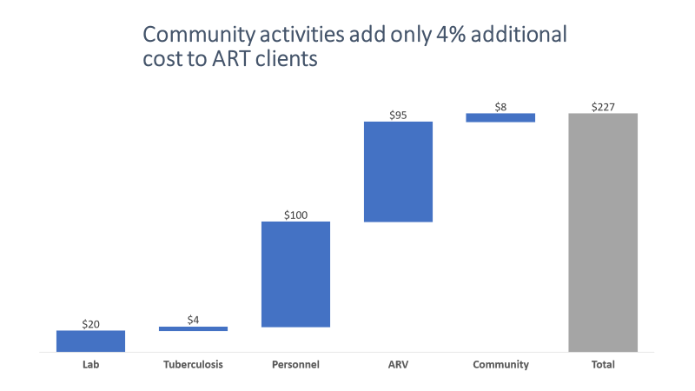
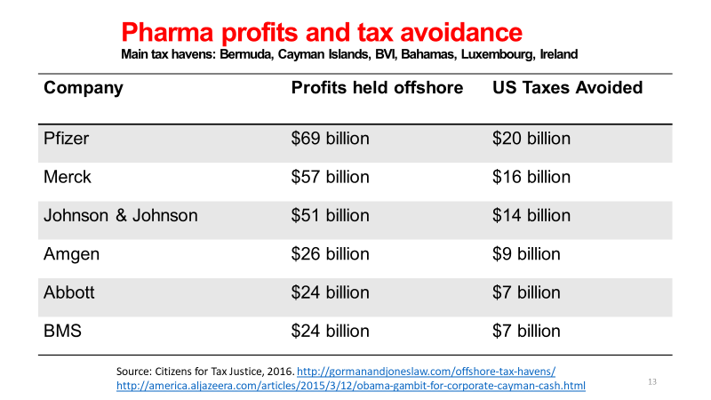
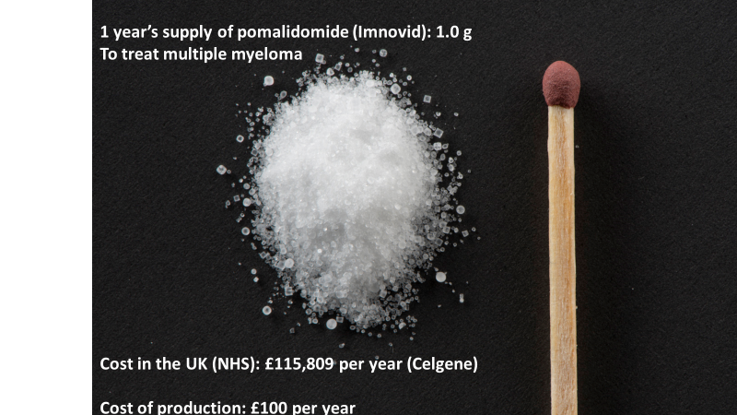
Financing
Major strides towards universal access to ART (Exceeding 15x15 targets).
High unsustainable prices persist partly due to market exclusivity/patents
Sustained donor funding and increased domestic funding is vital for the sustainable HIV response
Successful transition to new funding mechanisms requires accurate cost analyses.
Funding to local communities urgently needs prioritisation. Data on opportunity costs of community approaches which are key are however scarce due to focus on provider/facility level perspectives.

Slide 11
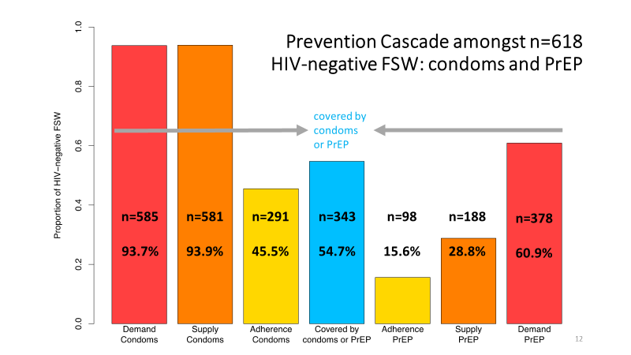
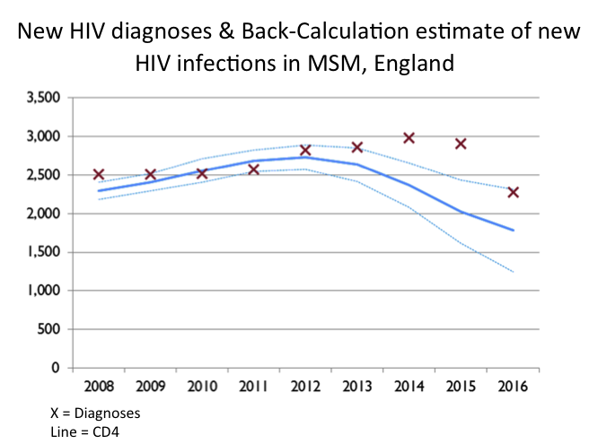
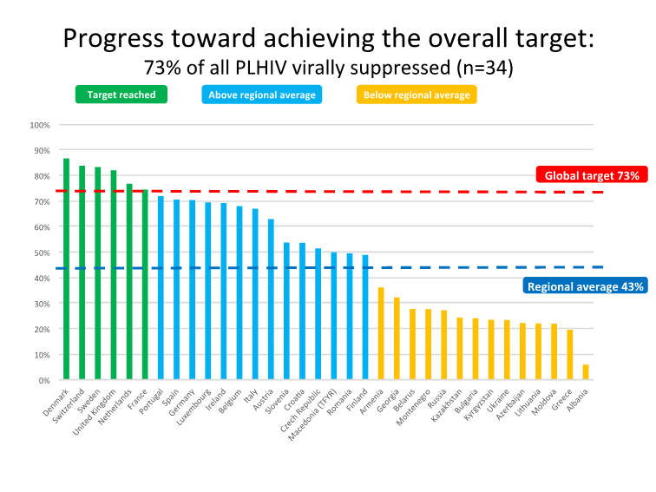
Data Systems
Toward strengthened routine data systems: still need robust, facility-level routine data systems
Key metrics at the macro level are essential for understanding where we currently are, and for political / resource advocacy.
Moving forward with the Prevention Cascade (Fearon, Weir)
CD4-back-calculations showed decline in HIV transmission dated back to around 2012 (session TUWS05)
Dashboards monitoring viral suppression performance across clinics helped target clinics for intervention to improve clinical-outcomes (Birx – WESS01)
New technologies to harness data, plus support people to use

Slide 12
The Implementers’ Conclusions
Implementation science agenda is evolving
Good examples of pragmatic impact evaluations
Process and formative evaluations describing implementation
Relatively few costing studies
Challenges remain: few reviews, hope to see more on Prevention Implementation Science next time, and evidence of new financing models
Key implementation lessons
Peers and communities critical for prevention and treatment implementation
Targeting and differentiation models critical for prevention and treatment
Intersectoral collaboration is critical and feasible, for financing and delivery
Data driven prevention and treatment is rising, but systems need support

